Slide 1
What is Grief?
Children’s Grief Awareness Day 2023

Slide 2
Children’s Grief Awareness Day 2023
Children’s Grief Awareness Day started in 2008. It is designed to help us all become more aware of the needs of grieving children and teens- and of the benefits they obtain through the support of others.

Slide 3
Mindfulness
Take a moment to breathe. Get your body ready. Close your eyes and notice 2 things you hear and 1 thing you taste. Take one big breath in and slowly release. Open your eyes. Let’s begin!

Slide 4
What comes to mind when you hear the word “grief”?

Slide 5
Grief is a mix of feelings and experiences we have after someone or something close to us dies.
Grief is...

Slide 6
Grief looks like...
Grief can look and feel many different ways. Grief doesn’t go away. It just changes over time.

Slide 7
Grief feels like...
Hard to concentrate
Headaches
Crying a lot
Trouble Sleeping
Chest pain or tightness
Body Aches
Body feels weak and tired
Empty feeling in stomach

Slide 8
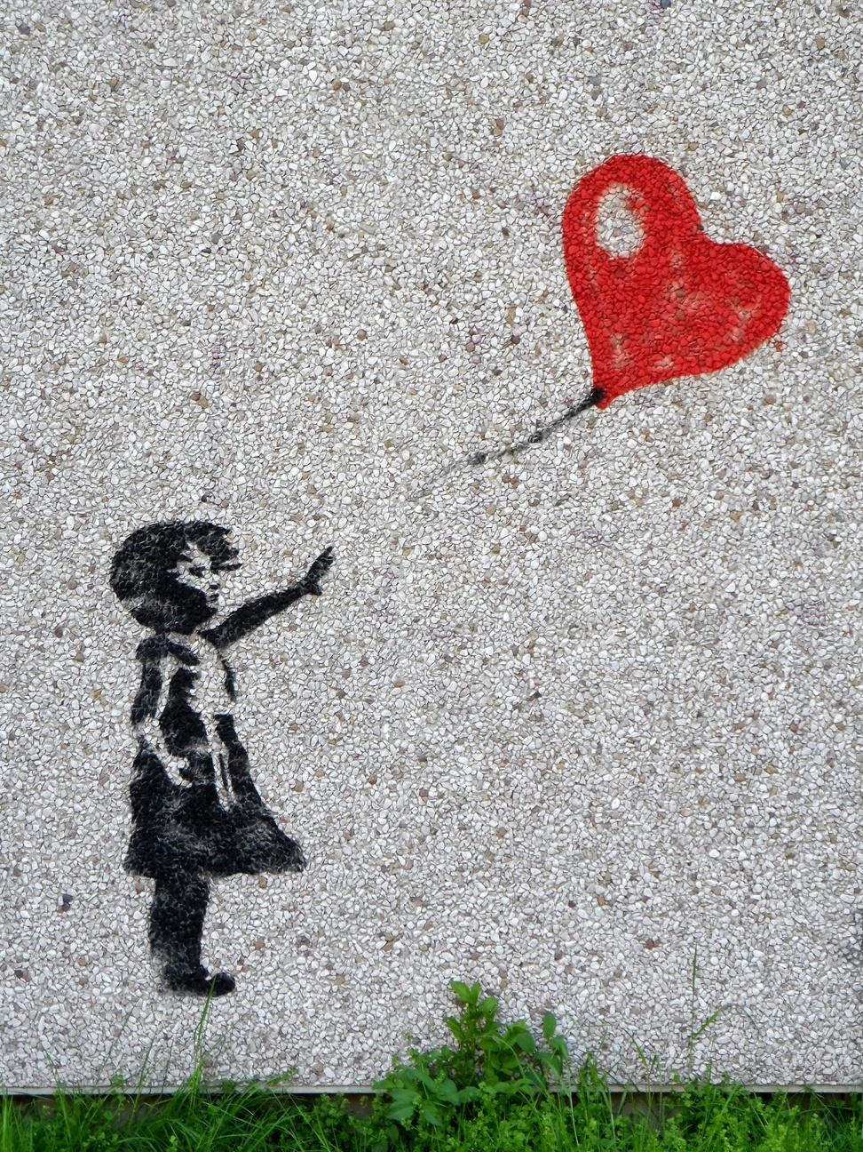
We can feel grief at other times too...
someone we love is far away
a pet dies
we move to a new home
we change schools

Slide 9
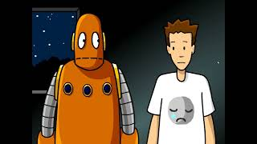
Dealing with grief

Slide 10
How have you dealt with grief?
Discussion Question #1
Discussion Question #2
Has anyone in here experienced grief?
What has helped you when your emotions feel overwhelming?

Slide 11
Who do you talk to when your emotions feel overwhelming?
Is there someone at school?
Is there someone at home?

Slide 12
How to Help a Friend Who is Grieving...
Create a card, picture, or words of encouragement.
Be patient and kind. They might be angry, sad, or confused.
Don’t ask questions about their grief. They may want you to sit quietly with them.
Say “I’m sorry” or “I’m here for you”.
Don’t talk about the death with other peers. If you need to talk to someone or have questions, find a trusted adult.
Don’t try to cheer them up. It’s okay if they’re sad. Just be there for them. They may still act like normal. If you don’t know what they want, just ask.
What if a friend is grieving?

Slide 13
We all carry our emotions with us, like a suitcase. Do you have a space that you feel safe enough to share your emotions?

Slide 14
Create a journal to write about your thoughts, feelings, and questions about grief.

Slide 15
Thank You for supporting Children’s Grief Awareness Day 2023!

