Slide 1
What is Grief?
Children’s Grief Awareness Day 2023

Slide 2
Mindfulness
Take a moment to breathe. Get your body ready. Close your eyes and notice 2 things you hear and 1 thing you taste. Take one big breath in and slowly release. Open your eyes. Let’s begin!

Slide 3
Grief is a mix of feelings and experiences we have after someone or something close to us dies.
Grief is...

Slide 4
Grief looks like...
Grief can look and feel many different ways. Grief doesn’t go away. It just changes over time.

Slide 5
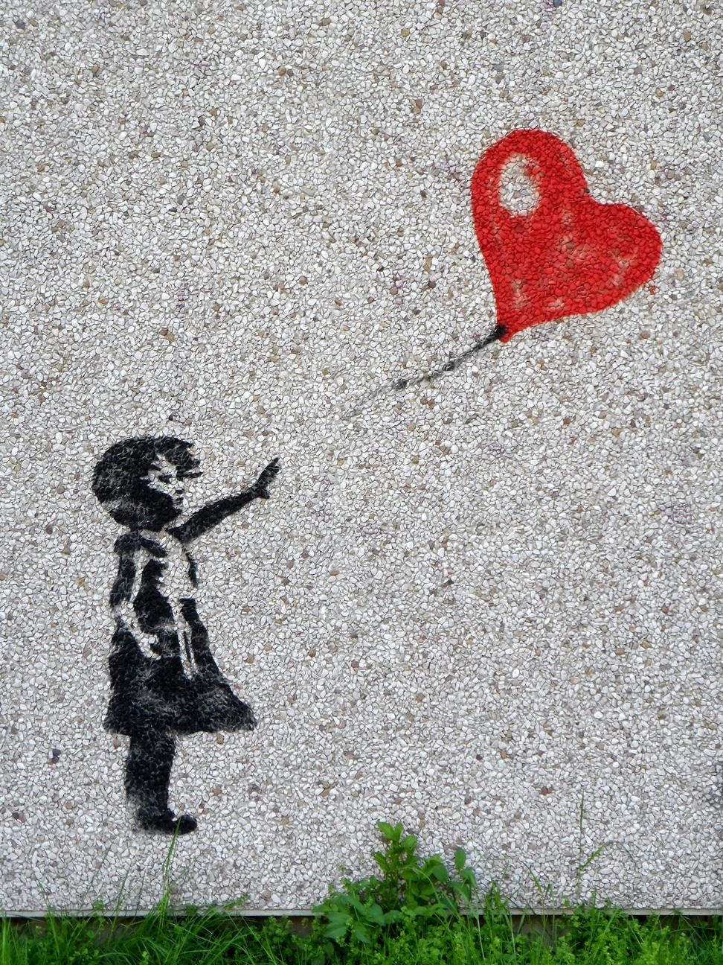
We can feel grief at other times too...
someone we love is far away
a pet dies
we move to a new home
we change schools

Slide 6
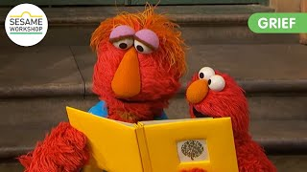
Dealing with grief
Elmo learns how to deal with the loss of a loved one.

Slide 7
Dealing with grief
Emotions change like the weather, and Grief can feel like we are weathering a storm.

Slide 8
How have you dealt with grief?
Discussion Question #1
Discussion Question #2
Has anyone in here experienced grief?
What has helped you when your feelings grow really big?

Slide 9
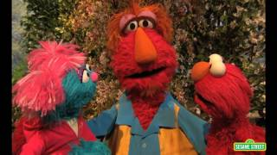
Coping with Big Feelings

Slide 10
Click the book cover to listen to The Rabbit Listened, narrated by the author,
Cori Doerrfeld

Slide 11
Click on the book to make your own support wheel.
How do you show support when others are showing big emotions?
How do you want others to support you?
What behavior might not look supportive?

Slide 12
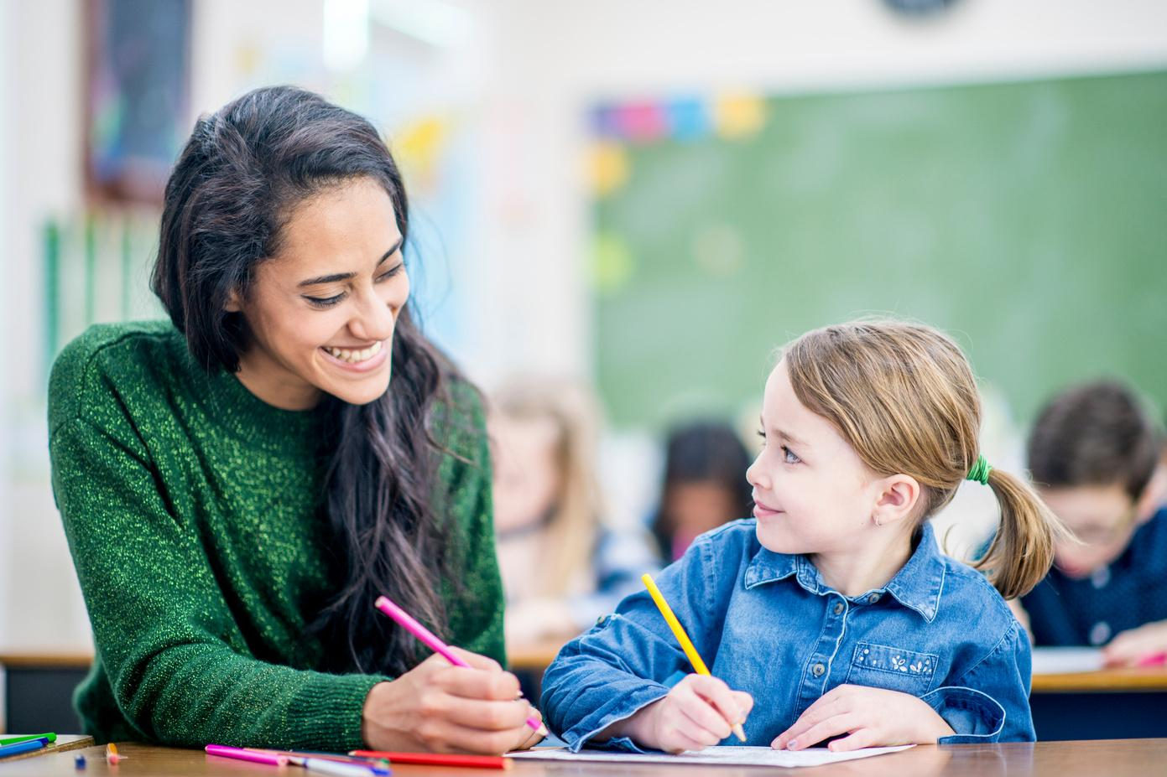
Who do you talk to when your feelings get really big?
Is there someone at school?
Is there someone at home?

Slide 13
How to Help a Friend Who is Grieving...
Create a card, picture, or words of encouragement.
Be patient and kind. They might be angry, sad, or confused.
Don’t ask questions about their grief. They may want you to sit quietly with them.
Say “I’m sorry” or “I’m here for you”.
Don’t talk about the death with other peers. If you need to talk to someone or have questions, find a trusted adult.
Don’t try to cheer them up. It’s okay if they’re sad. Just be there for them. They may still want to play like normal. If you don’t know what they want, just ask.
What if a friend is grieving?

Slide 14
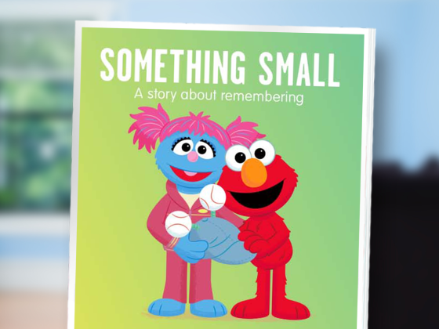
PreK-2
Click on the picture for a digital story about remembering.
https://sesameworkshop.org/resources/something-small/

Slide 15
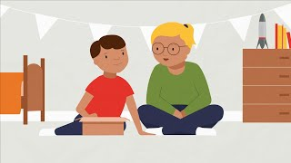
3-5
3rd-5th
Click on the picture for a video about remembering.

Slide 16
Thank You for supporting Children’s Grief Awareness Day 2023!

